Slide 1
Fund-raising
Relatively small projects - £20,000 to £75,000

Slide 2
The perfect project - Charlton

Slide 3
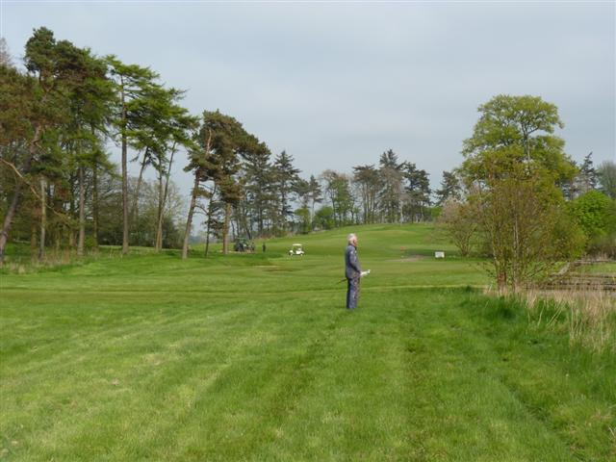

Slide 4
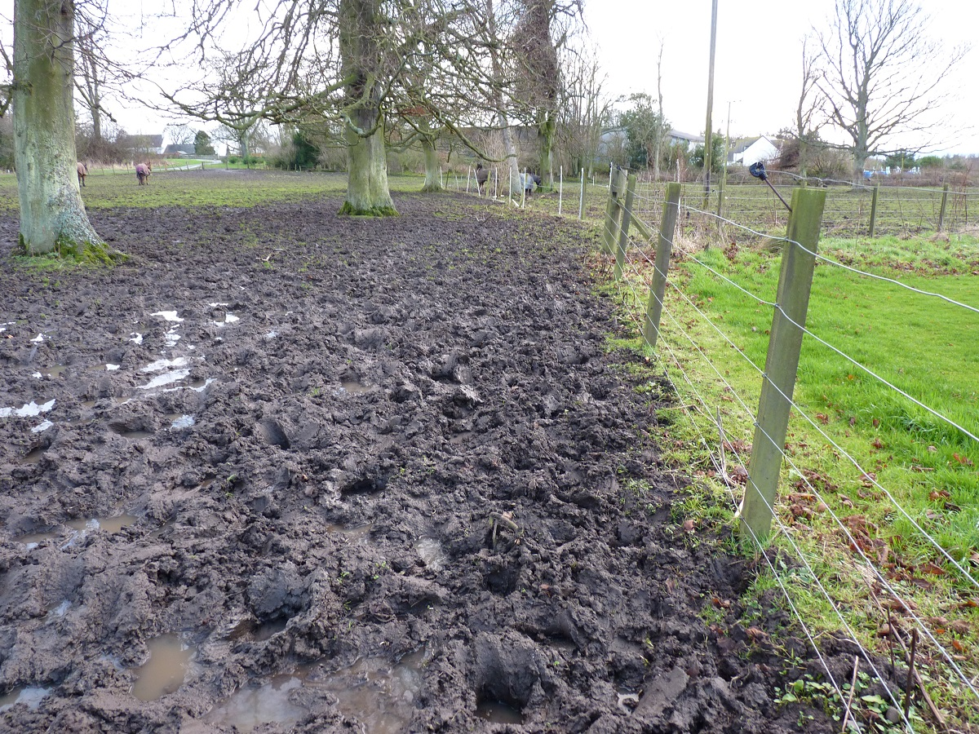

Slide 5
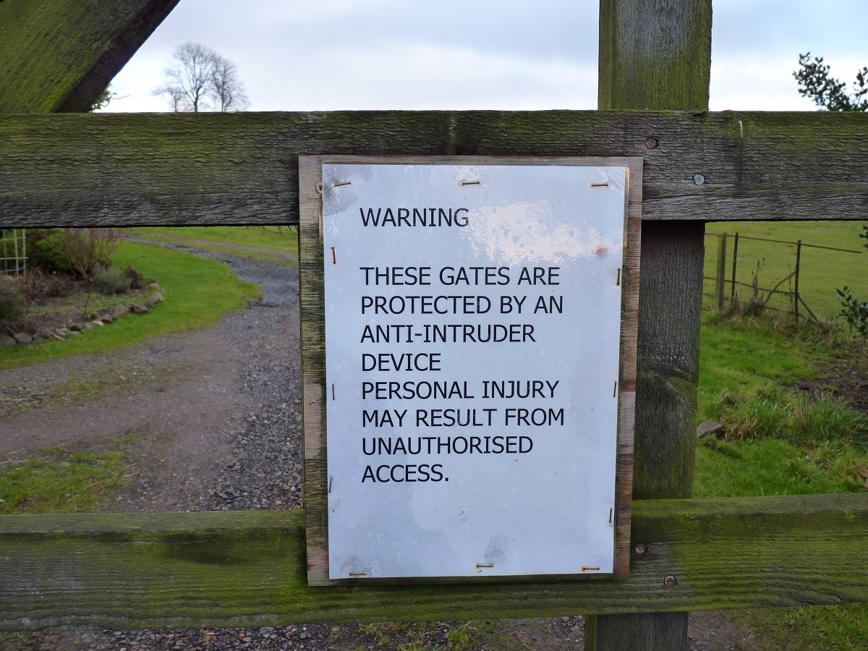

Slide 6
The scene is set ….
Pressure from councillors and public to sort out access issues
Land owner willing to have an alternative built
Horse riders being forced to use busy main road.

Slide 7
The approach
Contacted community council, they were fantastic!
Background work, application forms, bingo – got the money!
Council – legal agreement, tender documents, project managed.
Comm. Coun. – sent out and analysed tenders, organised opening party.

Slide 8
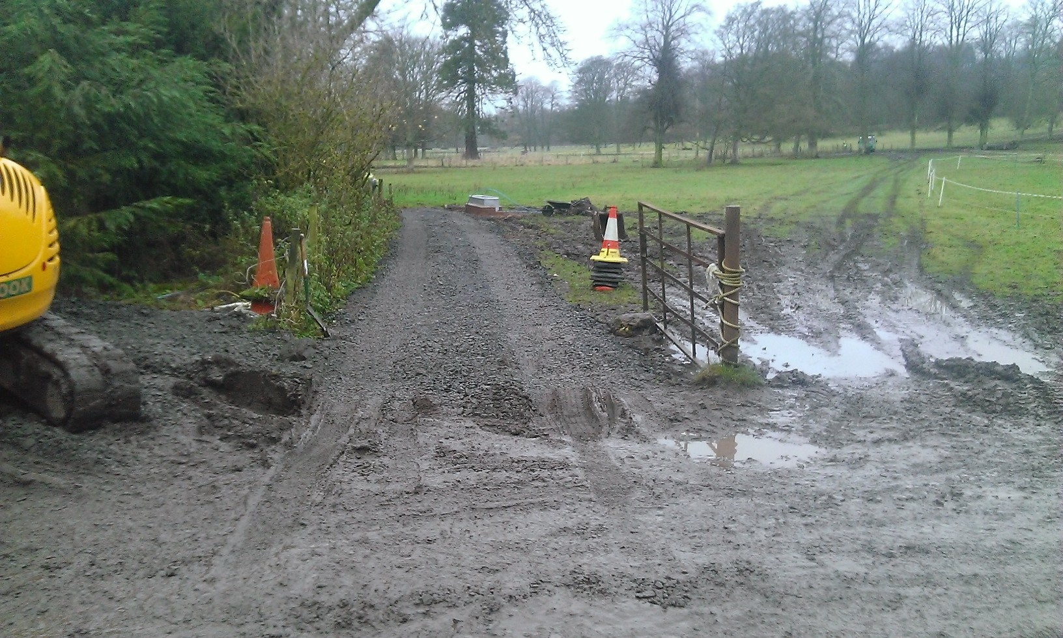

Slide 9
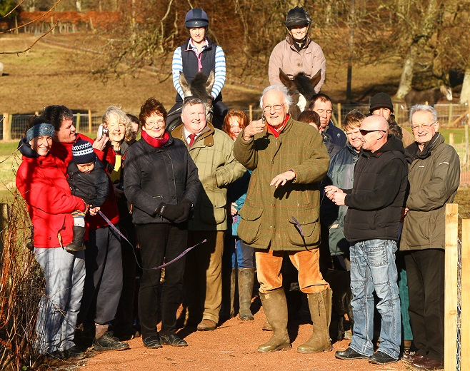

Slide 10
Lochgelly to Lochore Meadows Country Park
For more than 30 years there has been demand for a path here
A very boggy route sort of existed
Adopted as core path
Just waited for the right time

Slide 12
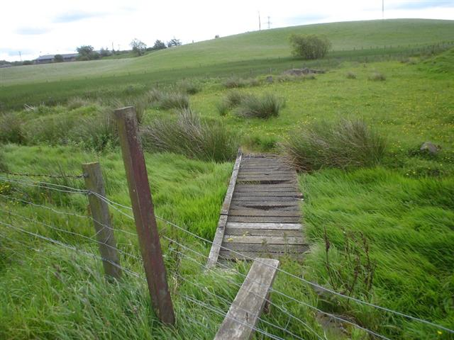

Slide 13
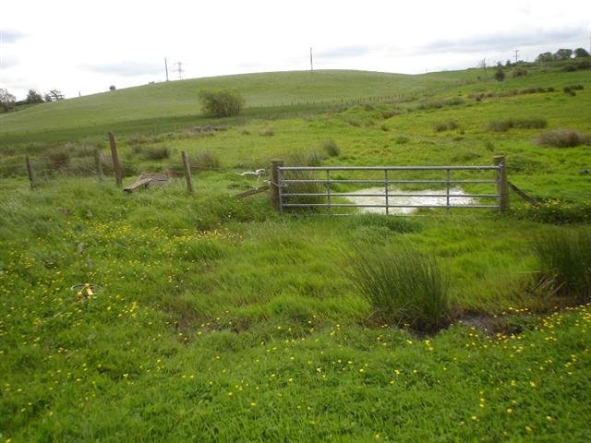

Slide 14
Key points
Emphasised long community aspiration
Links with school through Active Fife
Links with Lochore Meadows through Active Fife.
Council match funding available
Developing Mountain biking in Fife key to this success.

Slide 15
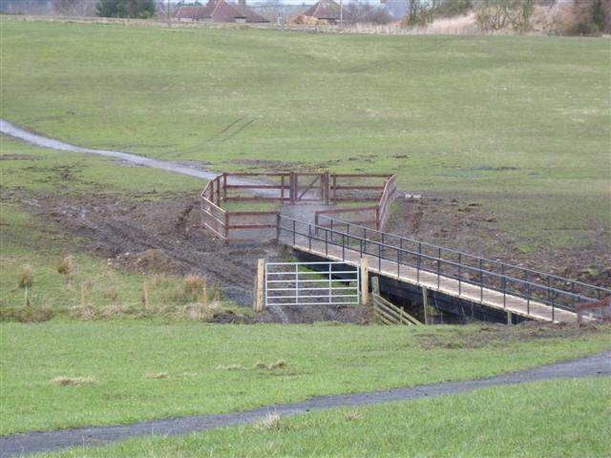

Slide 16
Lessons and pointers
Don’t apply for any funds unless you are pretty convinced that you match their criteria and the time is right.
Have a wish list at least, or a host of shovel ready projects, at best.
Make sure the community are really on-board with what you want, and involve them all the way.

Slide 17
Lessons and pointers
Make sure you have resources to look after what you are building.
I don’t recommend doing a project just because the money appears to be there – follow your priorities and plan rather than the cash.

Slide 18
Savour the moment!
I also walked the new path from the Meadows up to Lochgelly.....FABULOUS!..... What a great idea and such a lovely walk. Elaine
I’ve been stopped twice in the last week by people telling me how good the new link path from Lochgelly to Lochore Meadows is. This very rarely happens so I wanted to share with you some of their comments. Cllr. Hood

